Slide 1
Development of Microcontroller Based Wearable Device with Monitoring System for Body-Focused Repetitive Behavior
Ryan Christopher D. Bahillo & Iriks Maria B. Dalanon
BS in Computer Engineering, 4-1

Slide 2
INTRODUCTION

Slide 3
Background
According to a 2017 study of anxiety.org from Abrahams & Trotzky, Body-focused repetitive behavior (BFRB) is a term that refers to a group of compulsive habits that unintentionally harm one's body and alter one’s appearance but the factors that predispose individuals to these behaviors are poorly understood.
Pulling, picking, biting, or scraping one's hair, skin, or nails are examples of these behaviors. As many as 1 in 20 people have a BFRB, affecting both children and adults – Smitha Bhandari, 2020 from WebMD.

Slide 4
Common types of bfrb
Trichotillomania – hair pulling
Dermatillomania – skin plucking, also known as excoriation disorder
Onychophagia – compulsive nail biting.

Slide 5
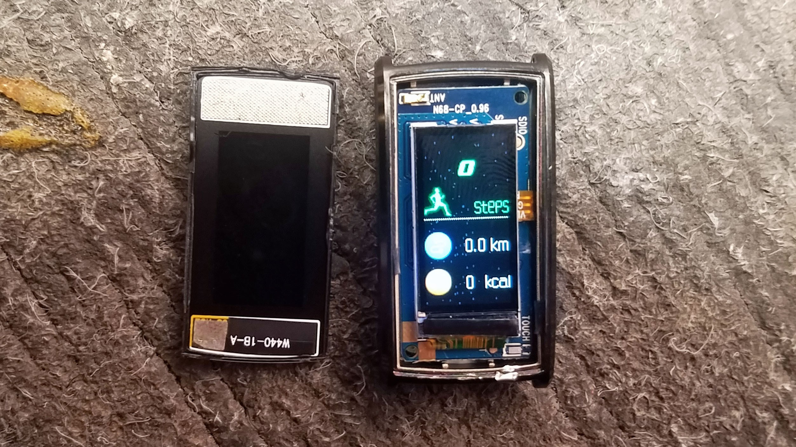
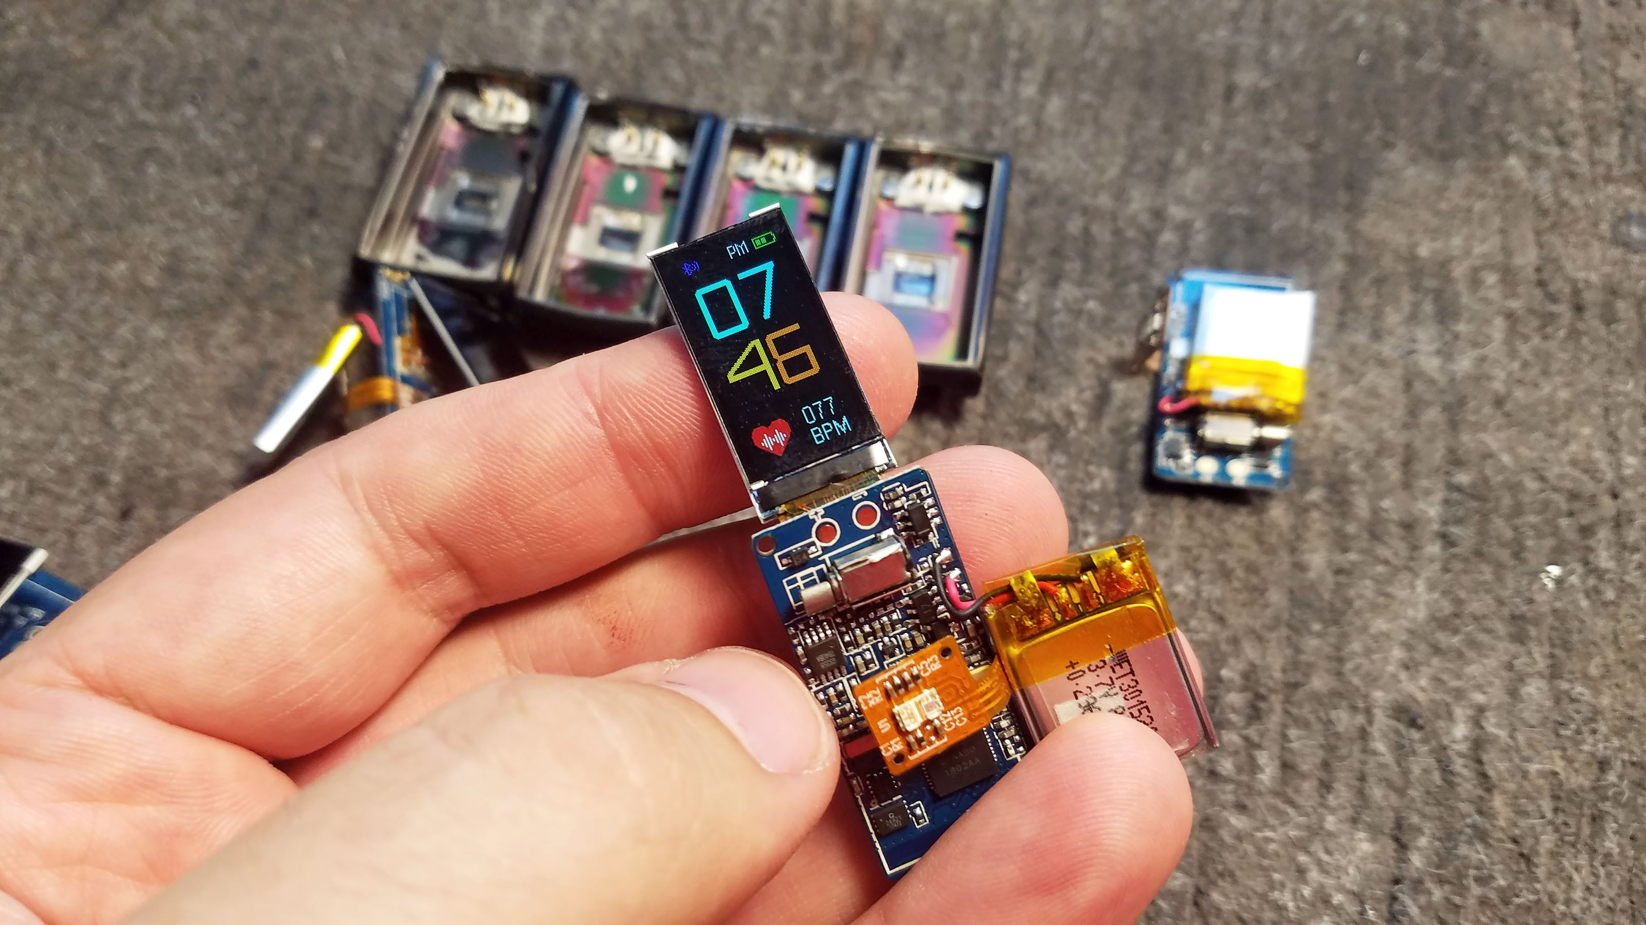
Previous Study
The “Tingle” by npj Digital Medicine, Child Mind Institute – They disassembled and used N68 Fitness Tracker as their main component for their PCB along with the MCU and IMU. However besides of the appearance, the price is on the expensive side and is not affordable for the public use.
https://hackaday.io/project/144350-hacking-wearables-for-mental-health-and-more

Slide 6
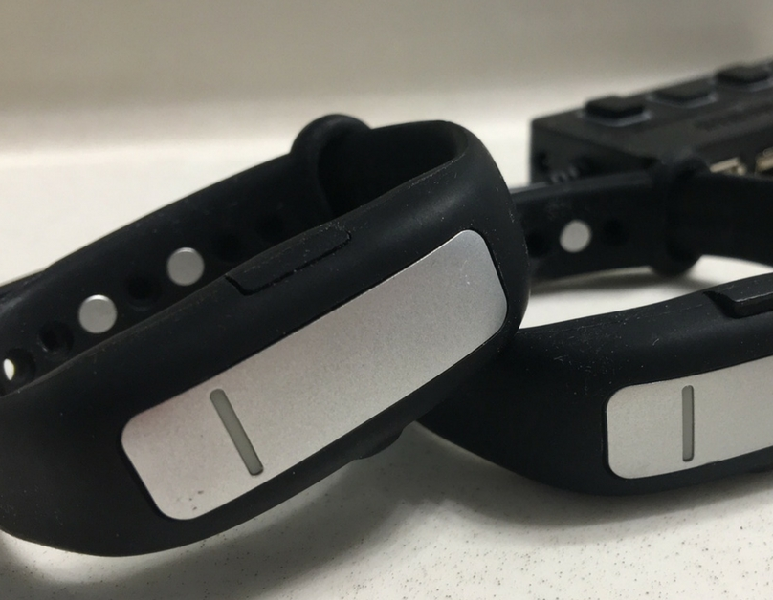
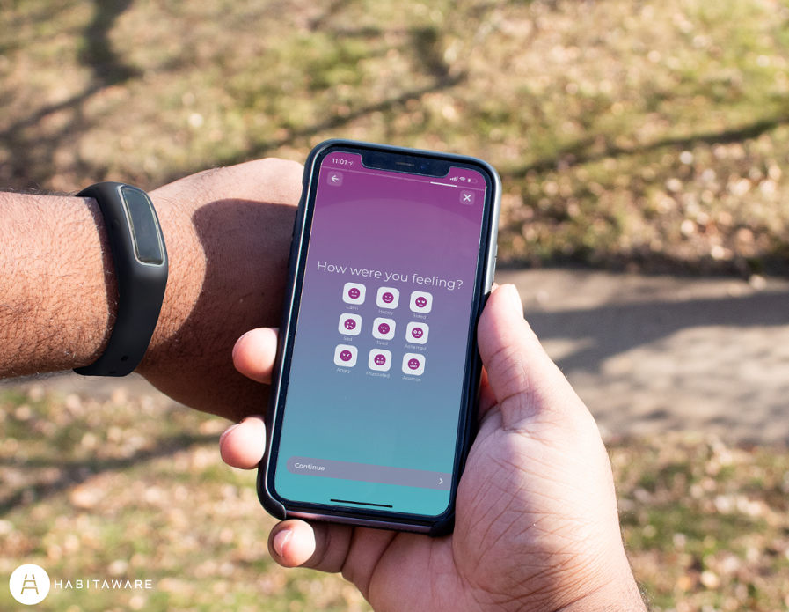
Previous Study
The “Keen” created by HabitAware – uses a gesture recognition for the initial use that makes the device recognize such habit. It then transmits a vibration signal to the patient wearing the device. Despite that, no published peer-reviewed study has shown the effectiveness of this device. There are testimonies that are presented in their website, but these are not great evidence to say that the device is well-suited for BFRB monitoring or treatment.
https://habitaware.com/

Slide 7
Objectives
To develop a microcontroller based wearable technology that conveys a signal to the patient.
To embed mobile application for motion sensors in real time.
To assist in the treatment of the Body-Focused Repetitive Behavior (BFRB patient) with the study.
To evaluate the effectiveness and performance of the wearable device such as hardware and software stability when predicting with a neural network.

Slide 8
RELATED LITERATURES

Slide 9
FOREIGN
David Christian Houghton 2019 – “Sensory Processing in Body-Focused Repetitive Behaviors” ways of treating BFRBs, behavioral interventions have been utilized to block symptom performance and induce extinction of the BFRB habit to permit fewer instances of symptom performance.
Lee & Lipner 2022 – Using N-Acetylcysteine (NAC) for the treatment of Trichotillomania, Excoriation Disorder, Onychophagia, and Onychotillomania found that it was effective in lowering compulsive behaviors in BFRB disorders.

Slide 10
LOCAL
Navarro et al., 2019 – a low-cost prototype was created by embedding a pulse rate sensor, Global Positioning System (GPS), and Global System for Mobile communication (GSM) modules in a wearable wrist band. Additionally, an SMS message is sent to an emergency contact, and a locating map may be seen on a smart phone or computer.

Slide 11
THEORETICAL FRAMEWORK
Kok et al., 2017 – it is necessary to precisely define the quantities obtained by the inertial sensors as well as characterize the usual sensor errors. These physical properties are monitored along three sensitive axes in 3D accelerometers and 3D gyroscope sensors. The criteria in sensor technology listed below are critical for proper functioning:
Coordinate frames
Angular velocity
Specific force
Sensor errors

Slide 12
METHODS

Slide 13
Research Design
Prototype design, development, and testing should all be carefully planned according to the breadth of the research questions and the available resources. Therefore, the researchers will facilitate prototyping by reducing cost and time and directly enhance prototype results.
“ We will have the development time that is significantly shortened by creating test samples. By doing this, the most important issues are exposed and helped to be resolved quickly. “

Slide 14
Materials
Arduino Nano 33 BLE Sense
VL53L0X Time-of-Flight Sensor
MAX30100 Pulse Oximeter and Heart-Rate Sensor
Micro Vibration Motor
601220 Lithium Polymer Battery
TP4056 Charger Module
SRAM 23LC1024
Single Pole, Double Throw (SPDT) switch
Micro SD Card Module
LSM9DS1 Inertial Measurement Unit (IMU)
MLX90614 Temperature Sensor

Slide 15
Estimated Cost
The budgetary estimate of this study is Php 5,100. The web interface can also cost money by deploying and maintaining the website running. However, there are free web hosting available online that can handle a limited amount of storage and memory usage.

Slide 16
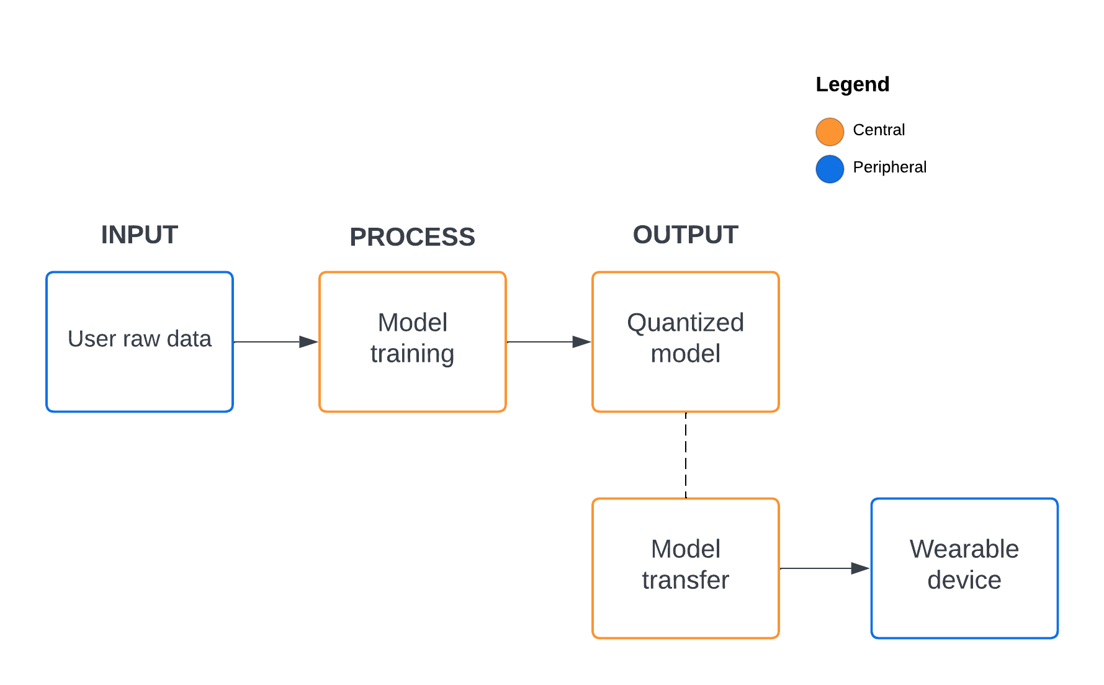
System Overview
The device will automatically record the position by using the IMU component as well as the temperature and distance sensor
It will train the model using the Long short-term memory (LSTM) neural network and send it via Bluetooth.

Slide 17
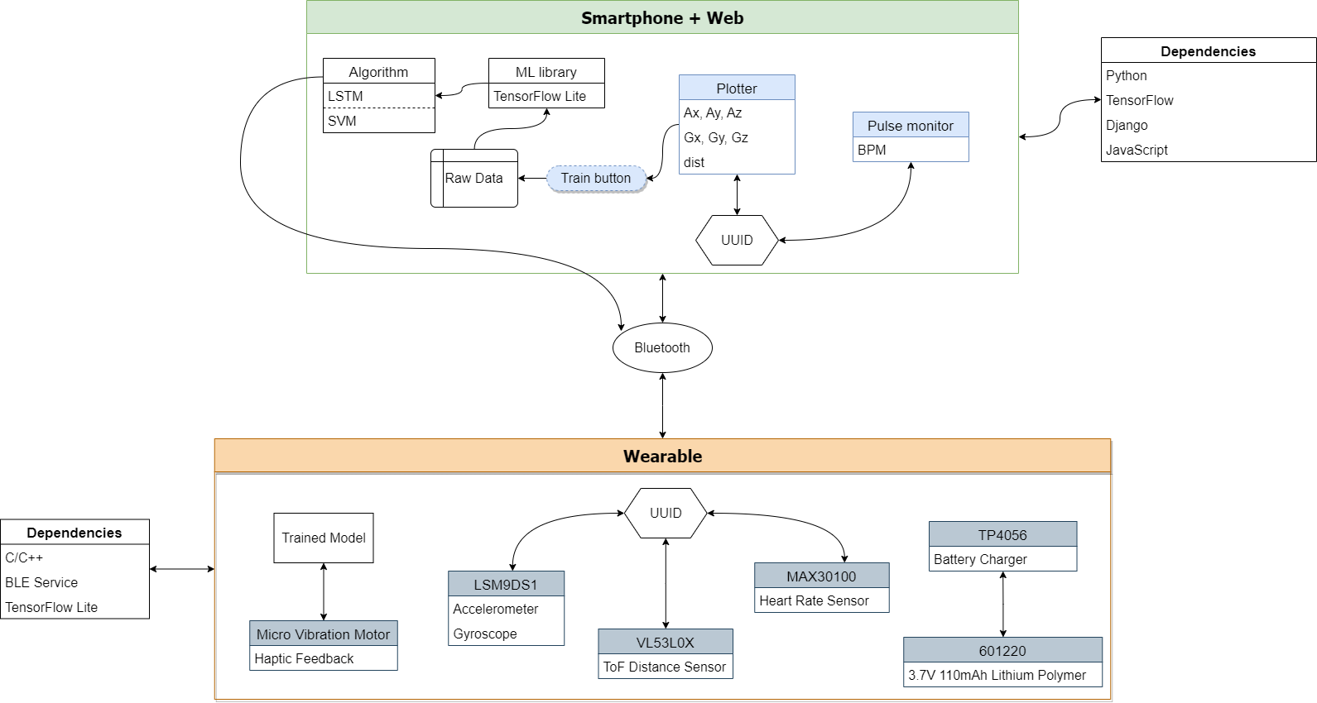

Slide 18
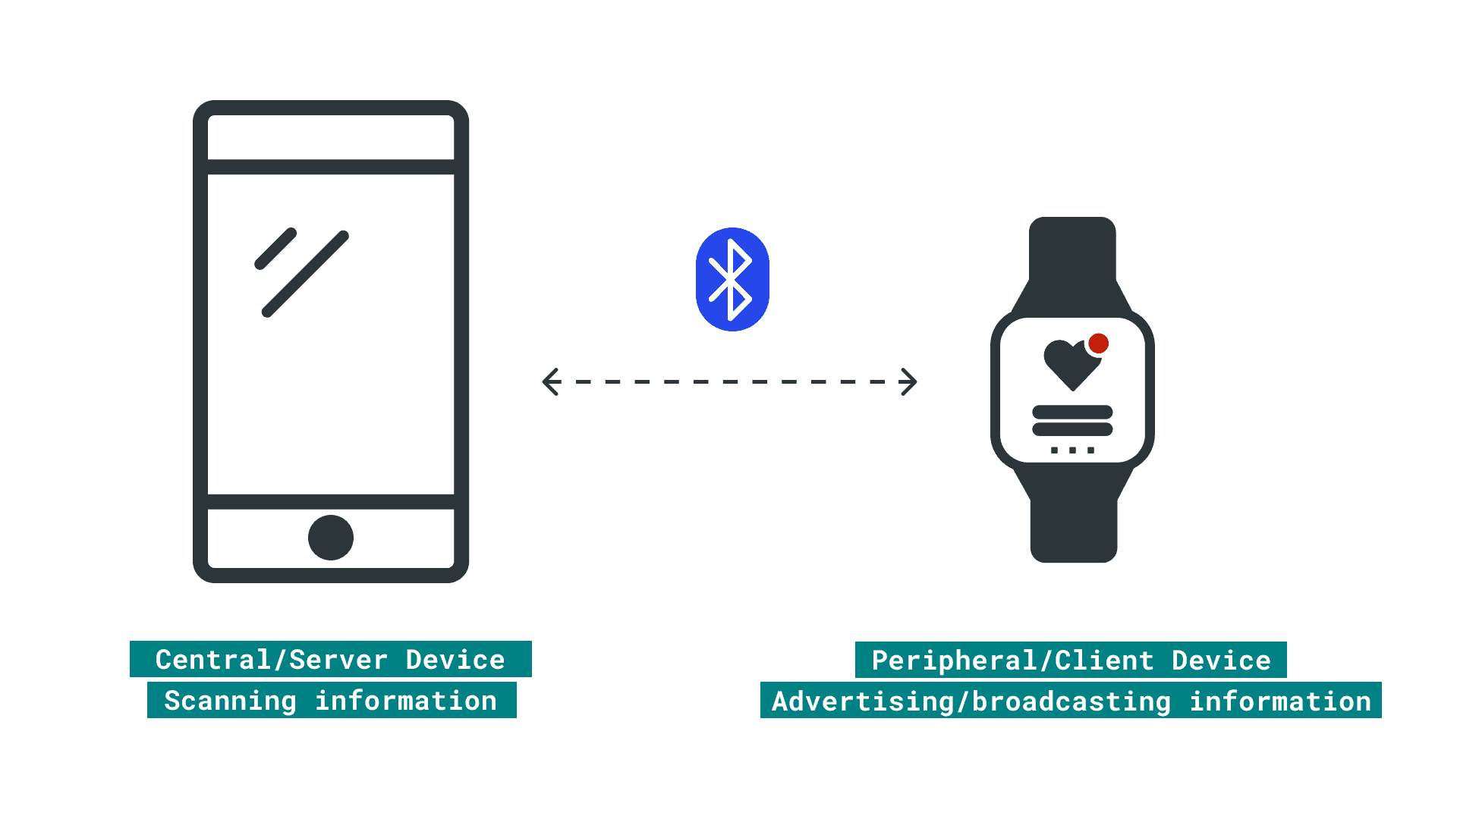
BLE Characteristic
Central – website acts as a server for pairing the wearable device.
Peripheral – wearable device, serves to send data over the web.

Slide 19
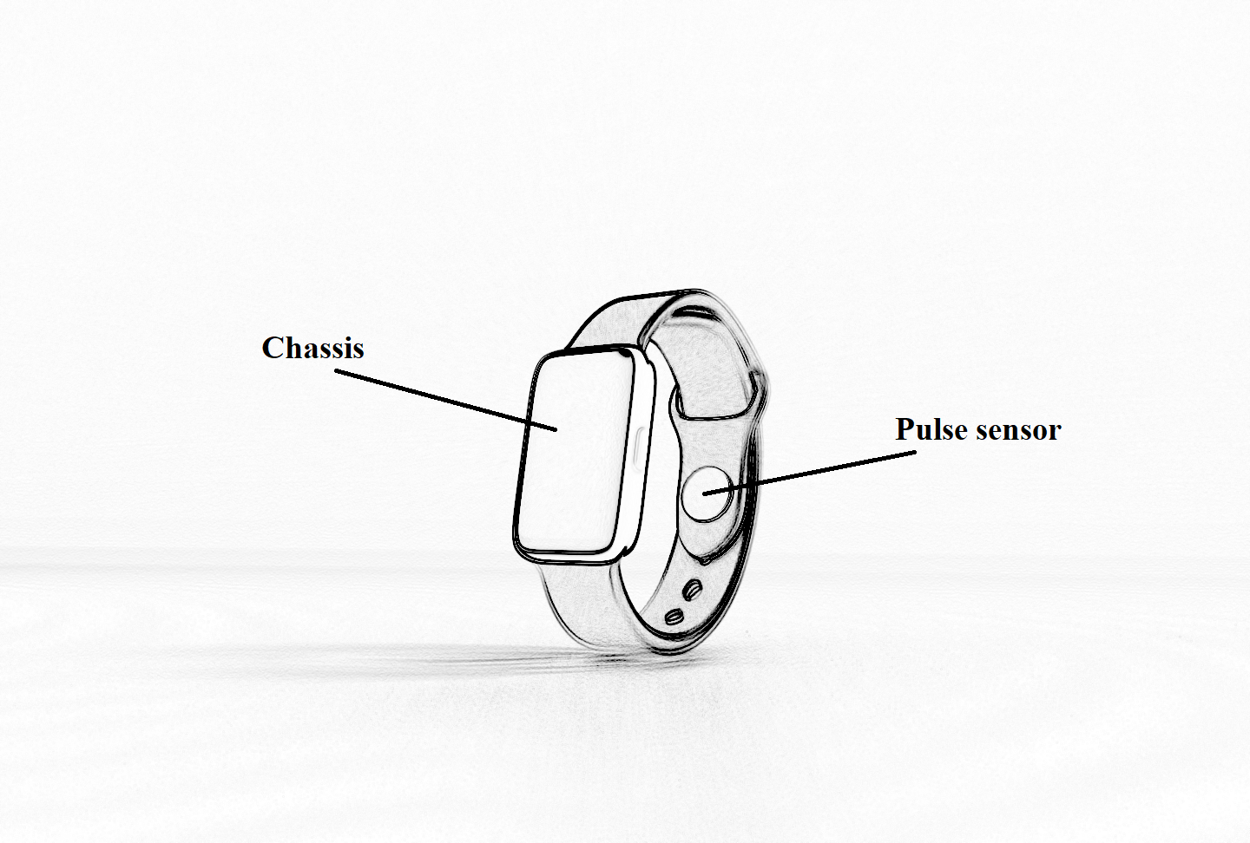
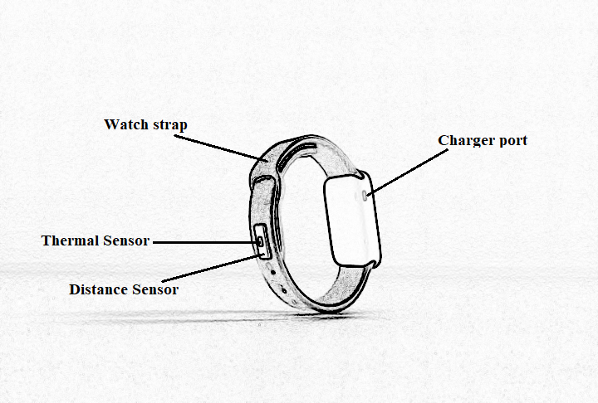
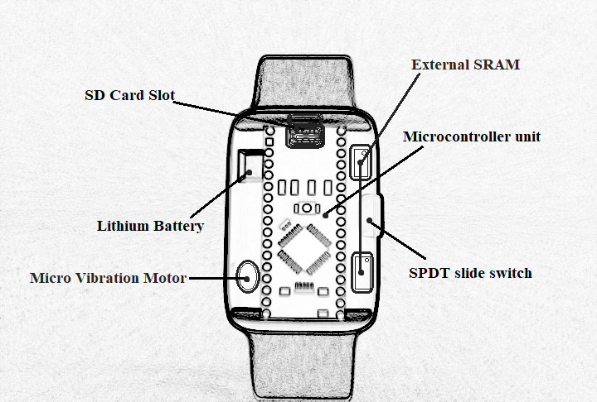
Design and Construction of the Wearable Device
Main components are shown in this figure. Including subcomponents like resistor, capacitor, wires, etc. Placement of the MCU in the chassis must be sturdy otherwise, the IMU recording will generate random and unstable numbers.
The purpose of placing these components externally is to make it the same pointing side of the user’s palm. Thus, contributes to the measurements of data for position tracking.
The main components are protected with a chassis to prevent it from any dirt/debris and water particles that may cause from destroying the entire circuit. The chassis are also expected to be 3D printed made with a strong filament of plastic to add durability.

Slide 20
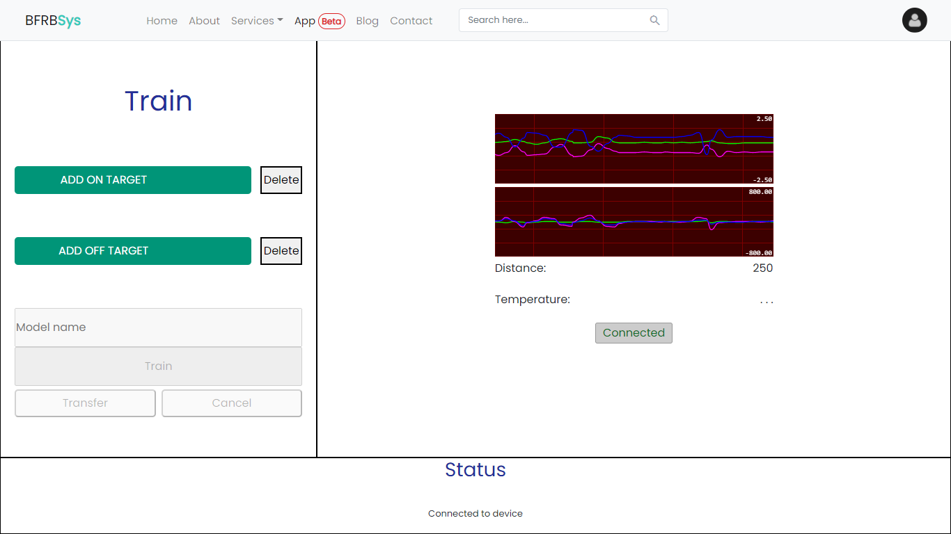
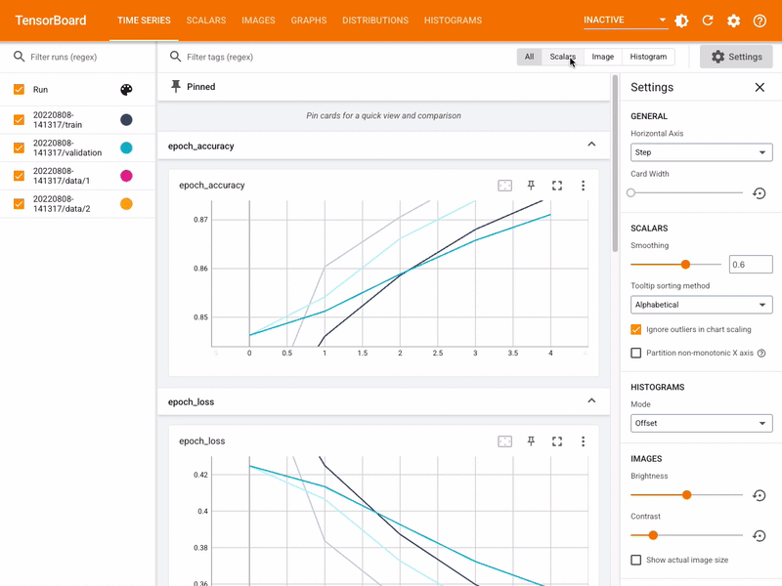
Design and Construction of the Web Interface
The user can view the validation accuracy and validation loss per epoch. The
researchers will also make the website user friendly than user can have ease
of using the interface
The training application, real-time monitoring system, and the status section where the success, progress, notification, and error are displayed in this interface. Device must be in the on-state and the user must turn on his/her Bluetooth on mobile before the connection.

Slide 21
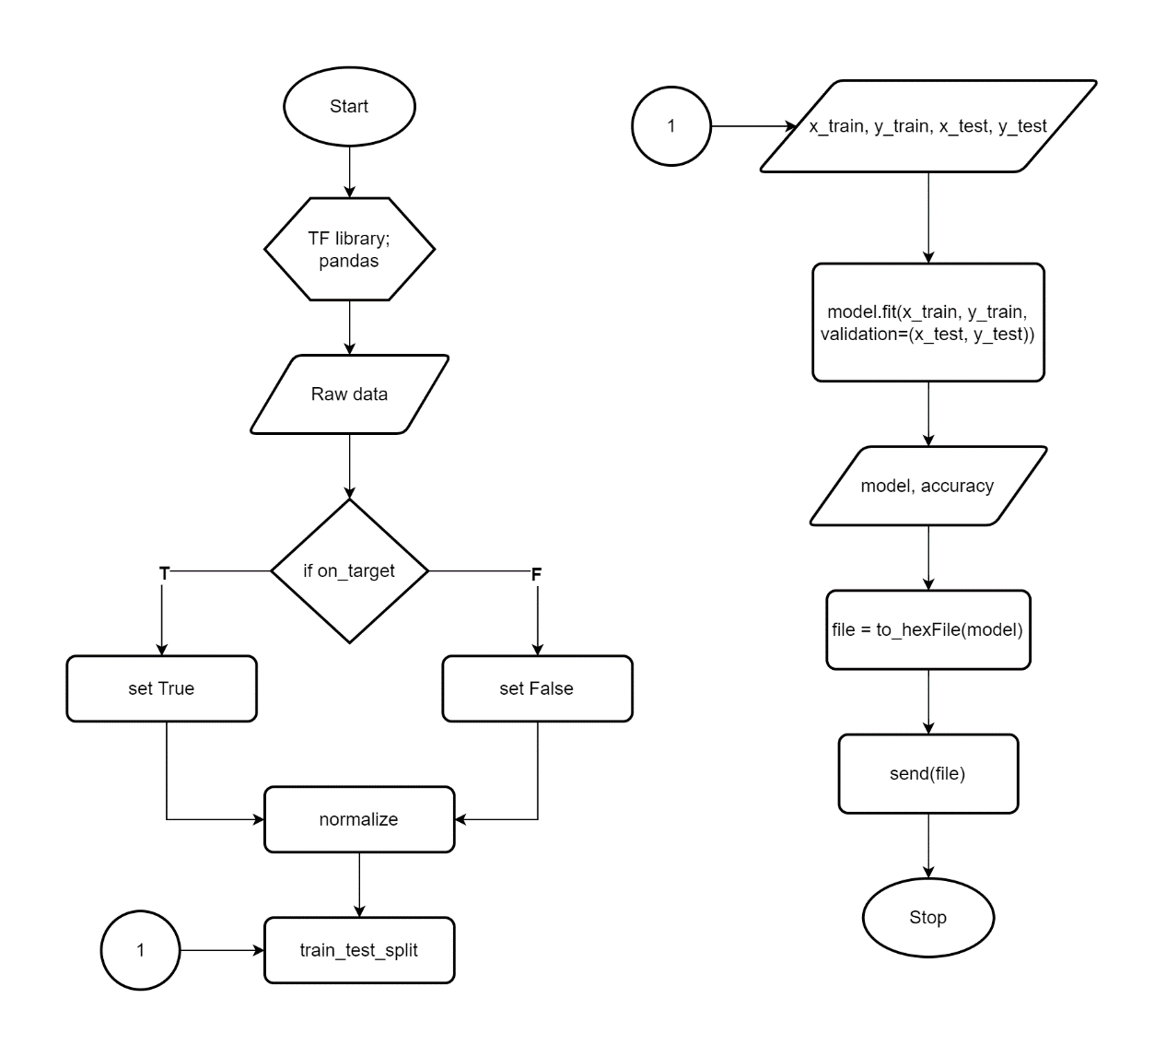

Server will filter and classify each data by marking it as true for on-target and false for off-target this is done using data manipulation and analysis.
Each data is then normalized and standardized to speed up the learning process and make each feature on a similar scale.
For example, the Arduino LSM9DS1 library accelerometer range is set at ±4 g and ±2000 degrees per second for gyroscope. Therefore, this range set values can be calculated as:
$$f\left(x\right)= \frac{x+|y|}{|2y|}$$
where x is the negative to positive readings and y is the min to max range value.

Slide 22
Thank you!

